Slide 1
IOT PLATFORM SYSTEM
BY :
SURAJ KUMAR G SHUKLA

Slide 2
INTRODUCTION
IoT Platform -> An IoT platform is a multi-layer technology that enables straightforward provision, management, and automation of connected devices. It basically connectshardware, however diverse, to the cloud by using flexible connectivity options, enterprise-grade security mechanisms, and broad data processing powers.
For developers, an IoT platform provides a set of ready-to-use features that greatly speed up development of applications for connected devices as well as take care of scalability and cross-device compatibility.

Slide 3
LITERATURE REVIEW
Consider the IoT Emulators in market.
Fritzing is one of the commonly used Web Portal providing IoT emulation.
It also facilitates project build-up and code testing.
Circuits.io is a similar platform , but differs on a note that it enables user to design and configure their own chip as well.
Despite of various advantages these platforms carry certain drawbacks as well.
These are :
No support for Layer 7 protocols like MQTT & CoAP.

Slide 4
It does not cover the application and business logic part.
It does not enable data sharing.
The Emulator may not match with actual hardware in real time application.
The proposed model provides the Infrastructure on a rental basis.
The User can Upload and view real time data
The model is meant for educational and research purpose.

Slide 5
IDENTIFYING PROBLEM
Emulation tools used in development do not take into consideration external factors affecting system .
Ex.1. MQ135 Gas Sensor works efficiently when , after its kept ON for 18hrs .
Ex. 2.DHT11 sesors reads humidity and temperature , emulation tools cannot provide real time data .
Developer need not worry on making circuit connection of hardware , and focus more on development and logic .
Each person need not have to buy new sensors and microcontroller instead use a single platform can be used by different users remotely .

Slide 6
Proposed System
The new system provides the Infrasture as a Service (IaaS).
The user can upload the code from remote location through interface provided connected via Internet.
The System follows time-slot booking mechanism for an individual user to book the platform and test the application.
It is 3 layers architecture
1st layer : At user side front End :
The user portal provides a login and registration form to use the services.
On successful authentication , user can book the services
User can upload and test the code.

Slide 7
2nd layer : Internet Network
Port forwarding at router to which RPI is connected.
3rd layer : On microcontroller backend :
The Portal uploads the user code to the Arduino
The RPI stores the sensor data in database read serially

Slide 8
Methods
Raspberry pi MicroController is connected to internet . Ardunio board is attached to Rpi via serial USB .
Port forwarding is done in router to ip of RPI.
CGI running in Rpi listens external requests from internet.
Apache server in Rpi hosts website for new user to register and book timeslot for using platform .
User writes his code in the form provided . CGI in pi accepts the code and saves in a file with extension .ino.
The .ino file is uploaded to ardunio board .
Data read by sensor , sent to RPI , read using serial communication at serial port .
This data is saved in database , and made available to user at realtime.

Slide 9
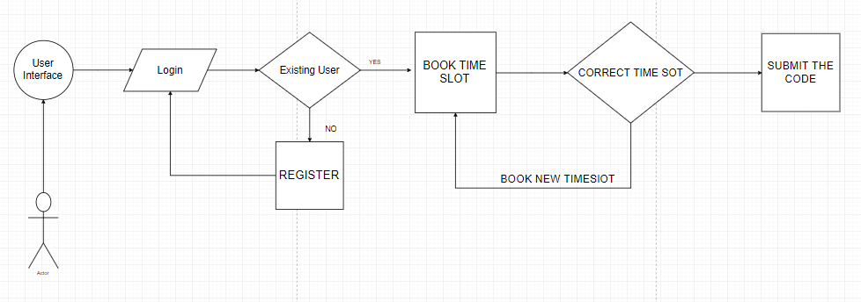
BLOCK DIAGRAM

Slide 10
